Slide 1


Machine Learning Project
Speech Emotion Recognition system
Under the Guidance of
Prof . D.A Torse
TEAM DETAILS :
Sl. No. | Name | SRN.
1 | Chidambar Patil | 02FE21BEC026
2 | Komal Melavanki | 02FE21BEC042
3 | Laxmi Kammar | 02FE21BEC044
4 | Praveen Magadum | 02FE21BEC064
Department of Electronics and Communication Engineering,
KLE Technological University’s Dr. M. S. Sheshgiri College of Engineering and Technology, Belagavi

Slide 2
CONTENTS :
SI. NO | CONTENTS
1 | Problem Statement
2 | Introduction
3 | Dataset preparation
4 | Methodology
5 | Block Diagram
6 | Modules / Libraries

Slide 3
Problem Statement
Develop a speech emotion recognition system using a Convolutional Recurrent Neural Network (CRNN) and deep learning algorithms which will be trained on a dataset of speech utterances labeled with their corresponding emotions.
Dept. of ECE

Slide 4
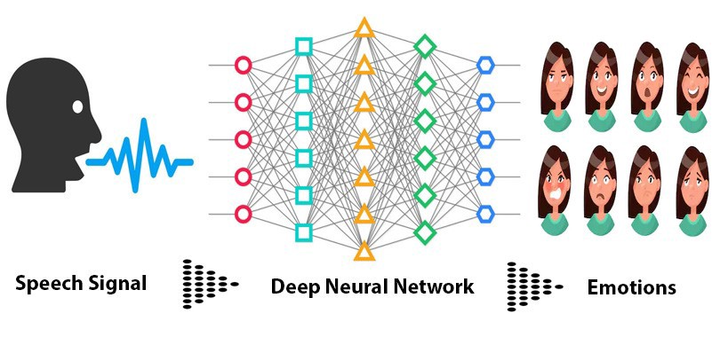
Introduction :
Speech emotion recognition (SER) is the task of identifying the emotional state of a speaker from their speech signal.
SER has a wide range of applications, including customer service, education, and healthcare.
Traditional SER systems rely on hand-crafted features and machine learning algorithms. However, deep learning algorithms have recently shown promising results for SER.
In particular, Convolutional Recurrent Neural Networks (CRNNs) have been shown to be effective at learning both local and temporal features from speech signals.

Slide 5
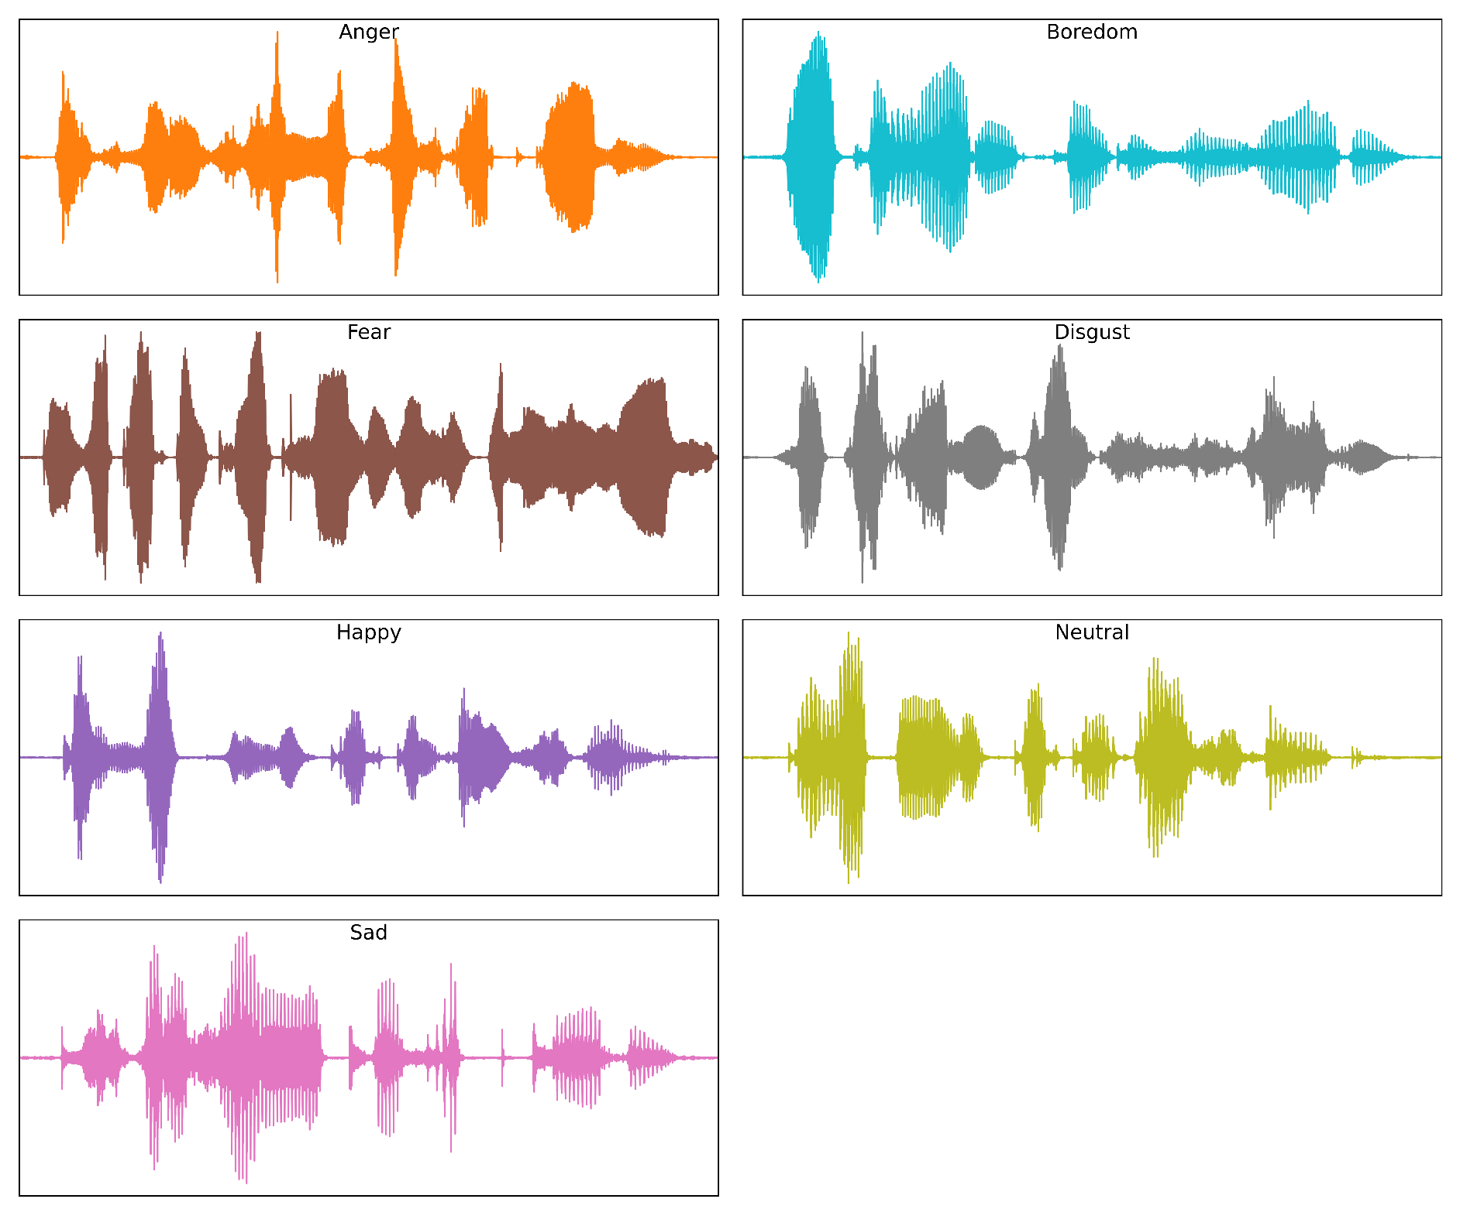
Dataset Information :
The data used in this project was combined from two different data sources as mentioned below:
TESS (Toronto Emotional Speech Set)
RAVDESS speech dataset
Recordings were made of the set portraying each of seven emotions (anger, disgust, fear, happiness, pleasant surprise, sadness, and neutral).
All audio files were recorded at a 16 kHz sampling rate, saved in wav format, with mono-channel and 16 bits per sample.

Slide 6
Methodology :
Input speech
Pre-processing
Log-mel-spectogram
CRNN
mLFLB1
mLFLB2
mLFLB3
mLFLB4
BiLSTM
Results

Slide 7
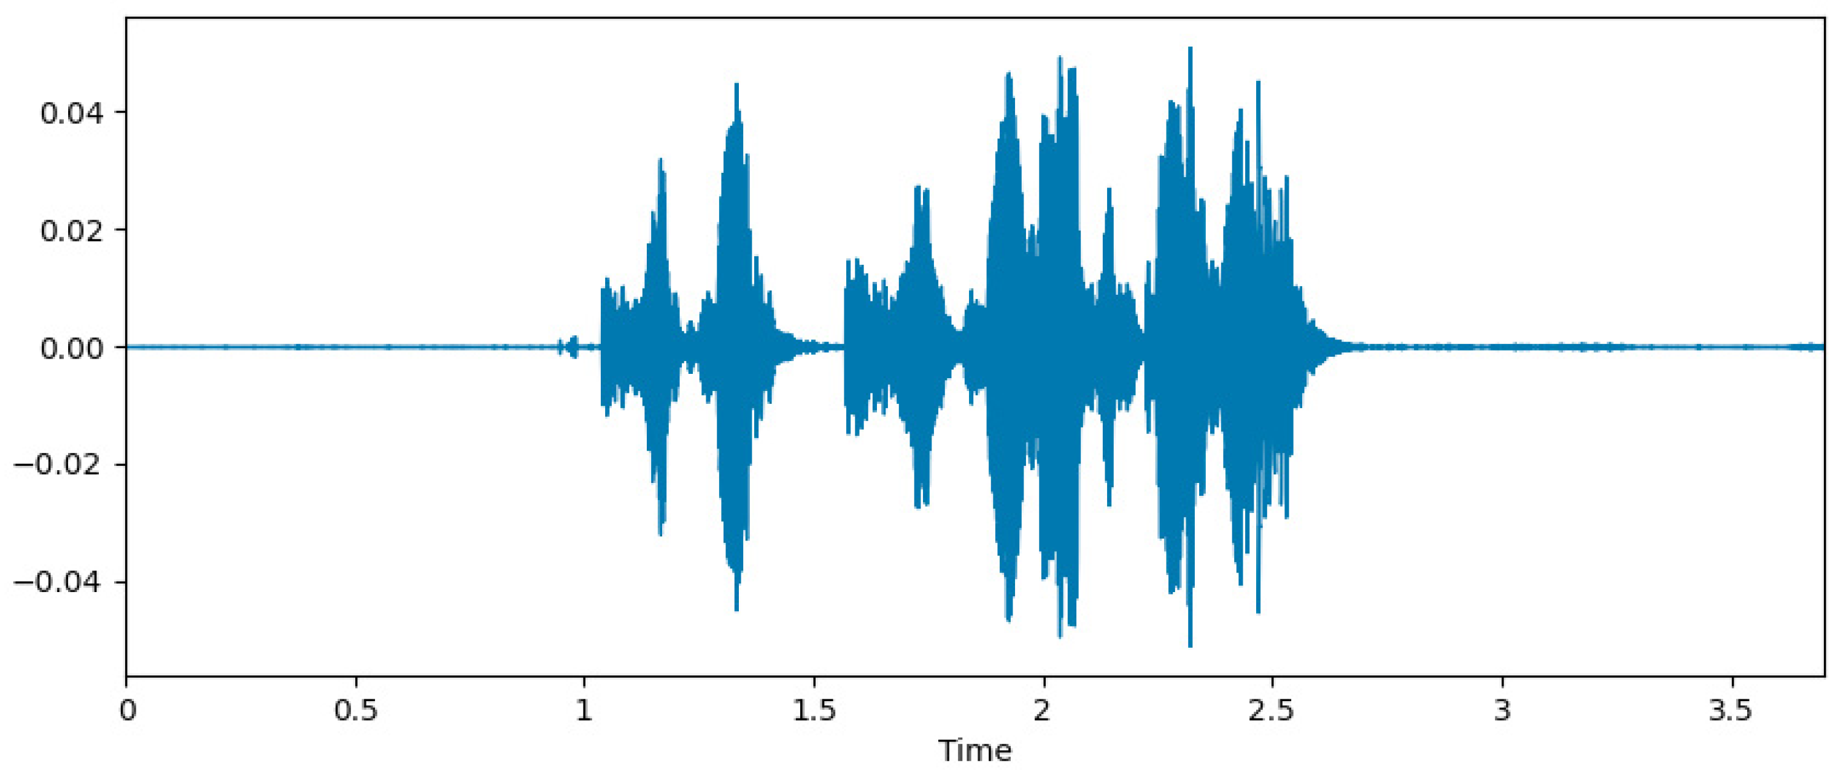
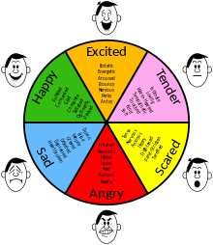
Block Diagram for project
Testing the model
Feature Extraction
Emotions classifications
Digital Signals
Features
Trained Parameters
Speech Audio signal
Training the model
Model Description for emotion

Slide 8
Modules / Libraries involved in Project
Library | Functionality
Pandas | Used to perform data manipulation and analysis
numpy | Used to perform a wide variety of mathematical operations on arrays
matplotlib | Used for data visualization and graphical plotting
os | Used to handle files using system commands
seaborn | Built on top of matplotlib with similar functionalities
librosa | Used to analyze sound files
Librosa.display | Used to display sound data as images
Audio | Used to display and hear the audio
warnings | To manipulate warnings details

Slide 9
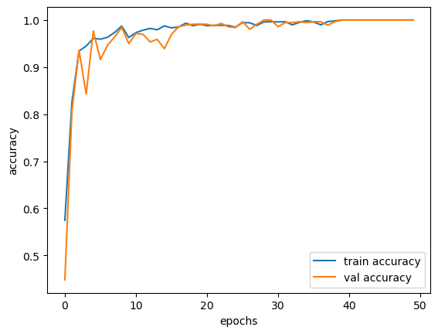
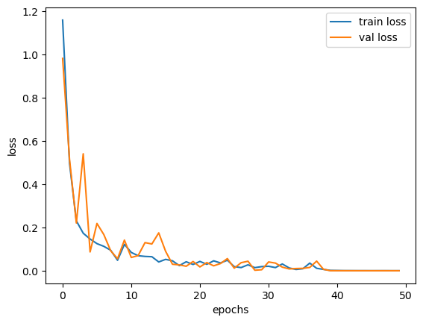
Results
Train Accuracy and validation accuracy
Train loss and Validation Loss

Slide 10
References
https://github.com/marcogdepinto/emotion-classification-from-audio-files?fbclid=IwAR2T4hhtWWfKdU4FwLS8LOAnF5sBwnmfc6PQHTGidzL aLl1uUVOvicx7TVw
http://www.elra.info/en/catalogues/catalogue-language-resources/
https://data-flair.training/blogs/python-mini-project-speech-emotion-recognition/
Github :
https://github.com/Praveenm15/MACHINE-LEARNING-/blob/main/speech%20emotion%20recognition%20using%20CRNN%20and%20Dl

Slide 11
Thanking You all

